Slide 1
ATTACK DETECTION USING DEEP LEARNING IN VANET
GUIDE: P.SRILAKSHMI
Ms. G. MAHALAKSHMI 2019272037
MCA-SS(3rd year)

Slide 2
INTRODUCTION
Vehicular Ad hoc Networks (VANETs) are the core of Intelligent Transportation Systems (ITS), allowing vehicles to communicate between themselves and with other entities.
The presence of a large number of communicating vehicles greatly increases the number and types of possible anomalies in the network.
However, since there can be a multitude of anomalies possible in the network, there is a need for better anomaly detection frameworks that can address this unprecedented scenario.
In this project, we propose an anomaly detection framework for VANETs based on Deep neural networks (DNNs) using PCA and DNN algorithms.
The DNN model learns the abstract and high-dimensional feature representation of the IDS data by passing them into many hidden layers.

Slide 3
IMPLEMENTATION PLATFORM / FRAMEWORK
Language used:
Python
tcl
Platform used:
Jupyter notebook
NS2 stimulator

Slide 4
OVERALL ARCHITECTURE (with completed modules highlighted)
FEATURE SELECTION AGENT
FEATURE IMPORTANCE CALCULATION
FEATURE SELECTION USING PCA
PRE PROCESSING
NORMALIZATION
LABEL ENCODING
DATA SET
Testing
Training
Not attack
CLASSIFICATION
STRATEGY
CLASSIFICATION
STRATEGY
DNN
DNN
Attack

Slide 5
LIST OF MODULES
PRE-PROCESSING:
Converting the data into numeric values and encoding it using label encoding technique.
Normalise the encoded dataset with the min-max techniques.
PRE PROCESSING
DATASET
NORMALIZED OUTPUT
LABEL ENCODING
MIN-MAX SCALAR NORMALIZATION

Slide 6
FEATURE SELECTION
Feature selection agent is the process of reducing the dimension of our dataset by selecting only the necessary features.
This is done using the feature importance calculations which calculates the information gain and entropy value. Then we perform the feature selection using the PCA (Principal Component Analysis) method.
FEATURE SELECTION AGENT
NORMALIZED DATASET
REDUCED OUTPUT
FEATURE IMPORTANCE CALCULATION
PCA(PRINCIPAL COMPONENT ANALYSIS)

Slide 7
TRAINING AND TESTING THE CLASSIFICATION ALGORITHM:
Training and Testing is necessary for us to know if the said model works.
The observations in the training set form the experience that the algorithm uses to learn.
The test set is a set of observations used to evaluate the performance of the model using some performance metric.
It is important that no observations from the training set are included in the test set.
In this DNN classification algorithm is used to train and test the dataset and check if the output we obtain is accurate. The accuracy can be tested using the accuracy formula.
CLASSIFICATION STRATEGY
REDUCED DATASET
OUTPUT
TRAINING THE MODEL
TESTING THE MODEL

Slide 8
NS2 ATTACK STIMULATION
NS2 is a discrete event simulator targeted at networking research.NS2 is an object oriented simulator, written in C++, with an OTcl interpreter as a frontend.
NS2 use Tcl language for creating simulation scenario file.
Network topology, transmission time, using protocol etc are defined in scenario file.
For this module, I have installed ubuntu 20.4 and in that NS-2.35 stimulator has been installed.
Then the aodv.cc is changed accordingly and attack.tcl file is generated.
Attack.tcl
File with attacker node
Run the stimulation
Attack.nam file

Slide 9
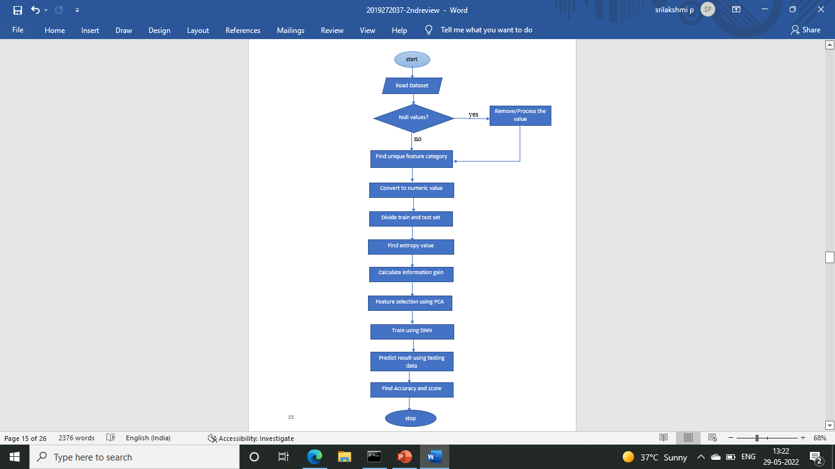
ALGORITHM STEPS
Algorithm:
Input: kddcup99,UNSW-NB15 dataset
Output: Normalized data
Start
Read dataset
If(Null values),then replace.
Else, (identify Unique feature category).
Convert data using encoding.
Divide the train and test dataset.
Perform min-max normalization.
Calculate entropy using Entropy = -(p(0) * log(P(0)) + p(1) * log(P(1)))
Calculate mutual information gain
Use feature selection agent to perform PCA .
Use the reduced features to train the Model with reduced features.
Predict the result.
Stop

Slide 10
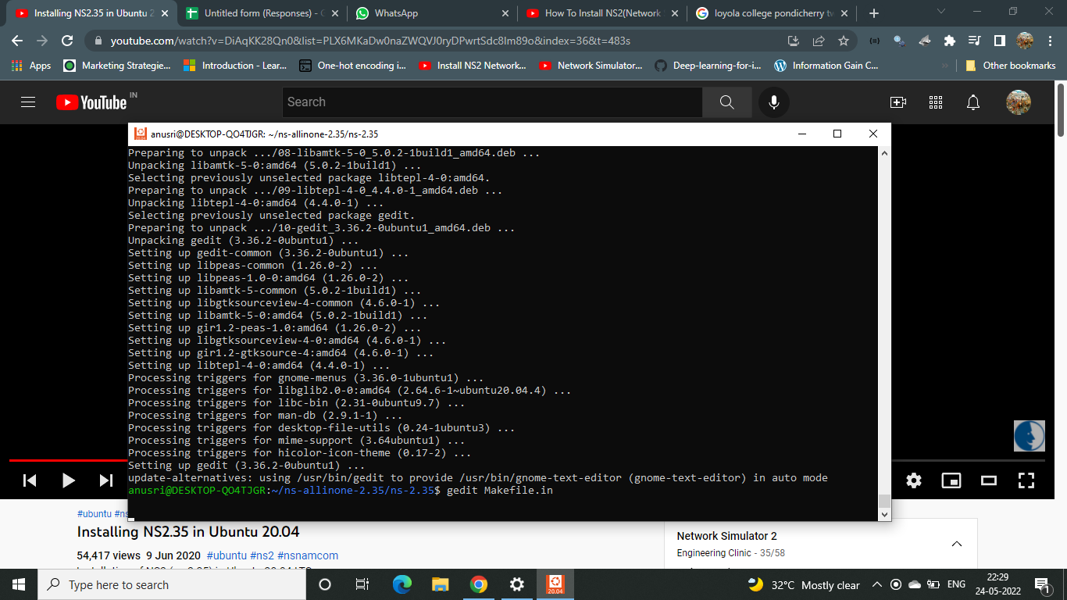
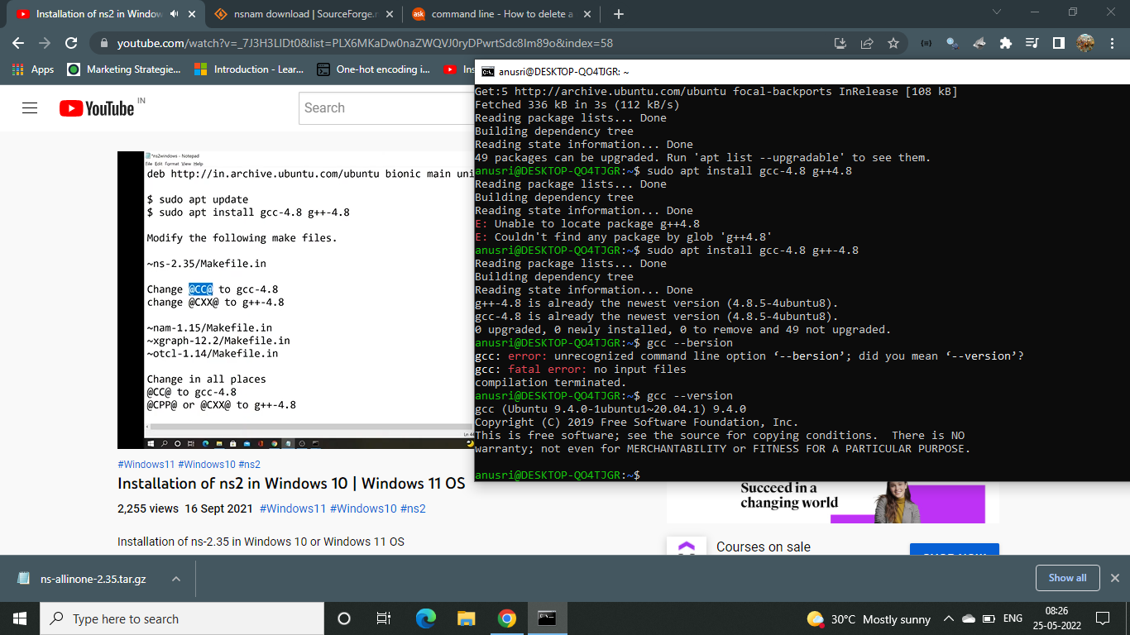
MODULE BASED OUTPUT SCREENSHOTS
Installing ubuntu: First we will download the ubuntu from Microsoft store and also install wsl.
Then make changes in makefile.in and install.

Slide 11
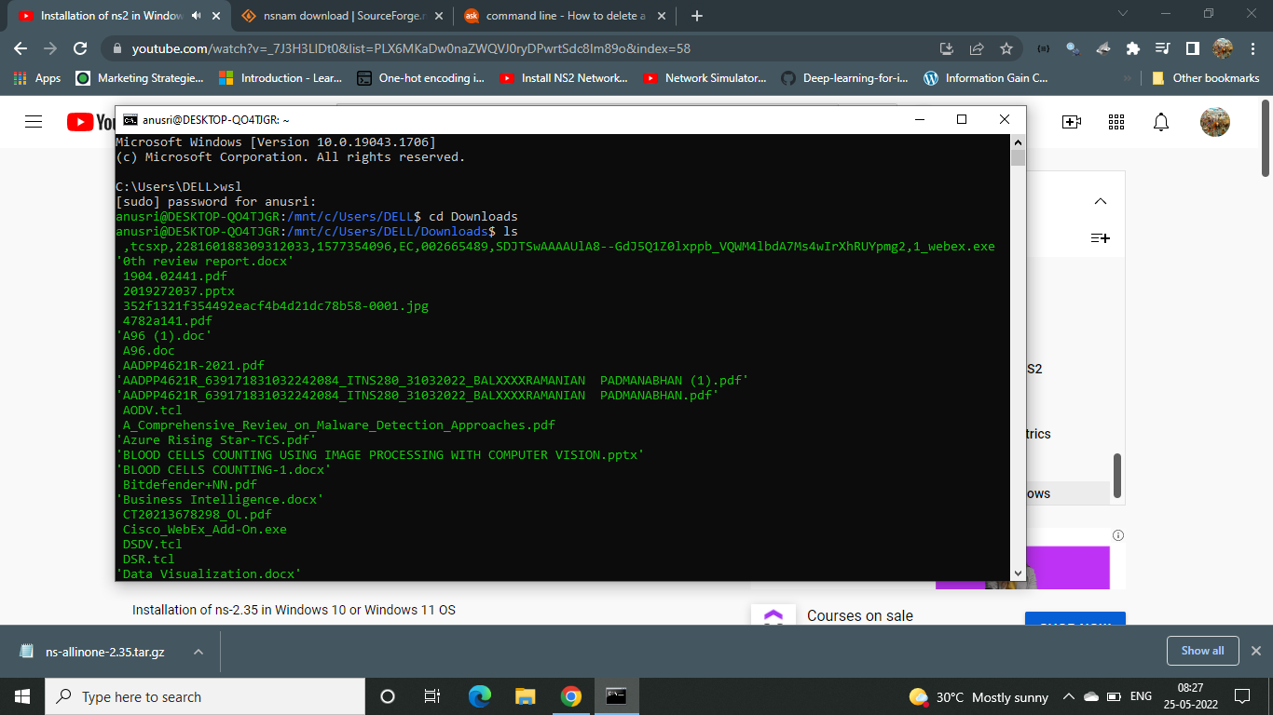
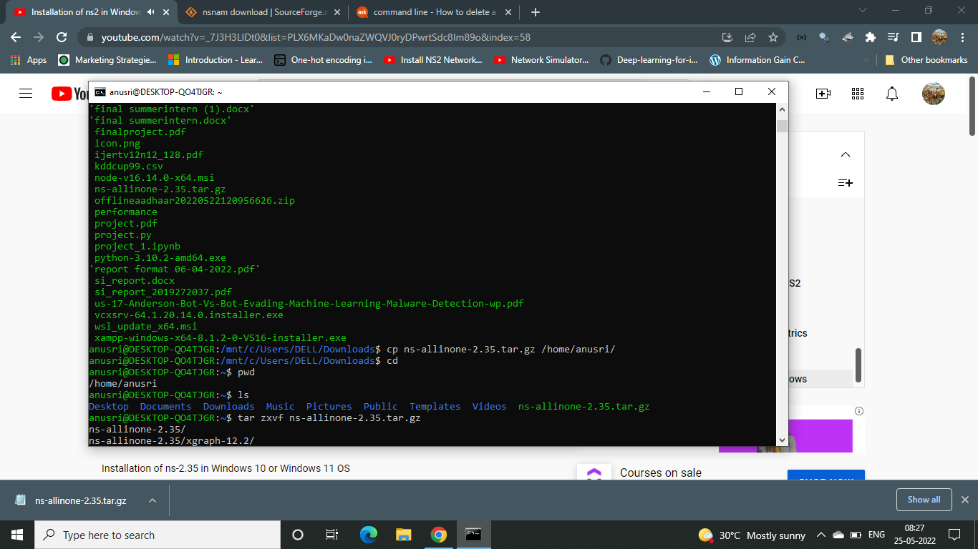
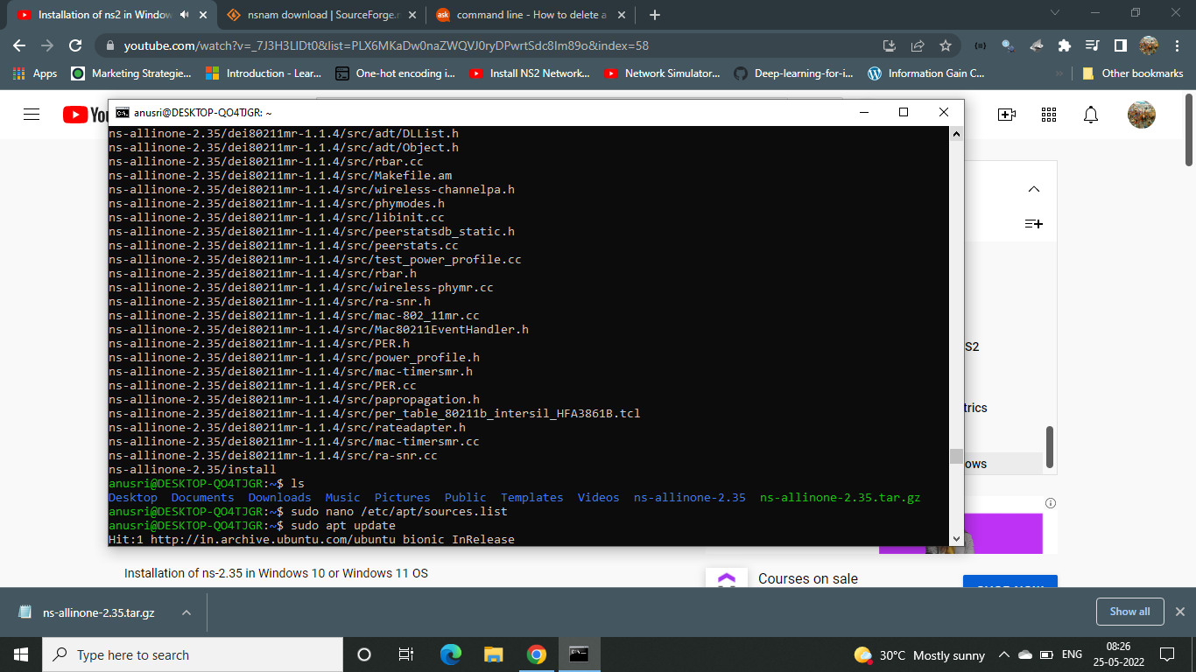
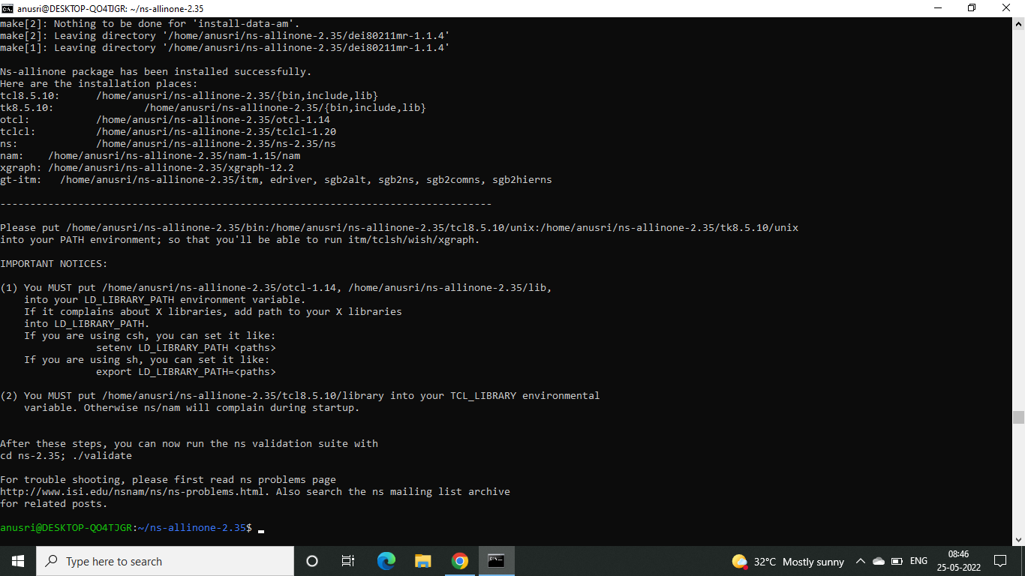
Unzip the downloaded NS2 stimulator folder and install them

Slide 12
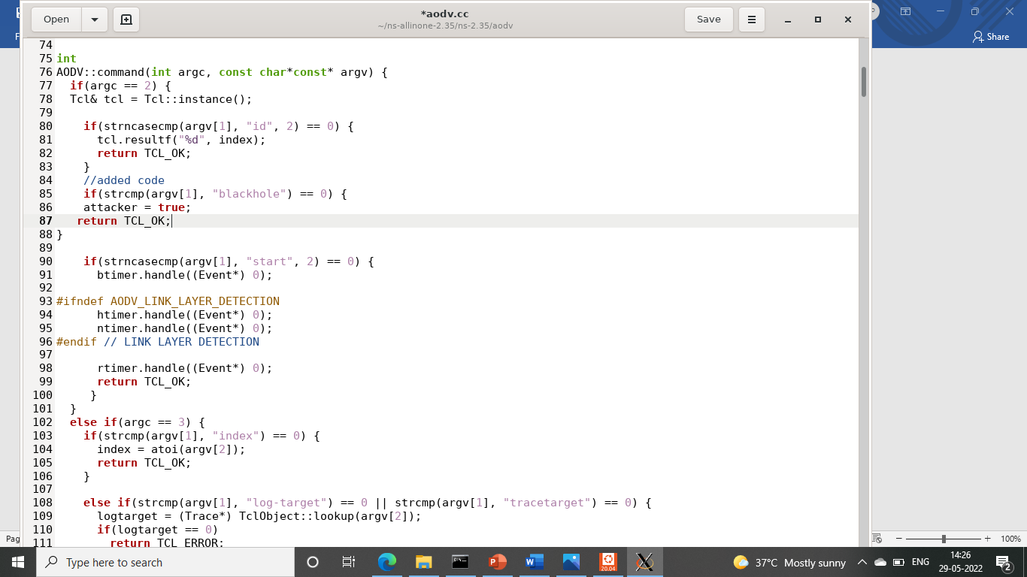
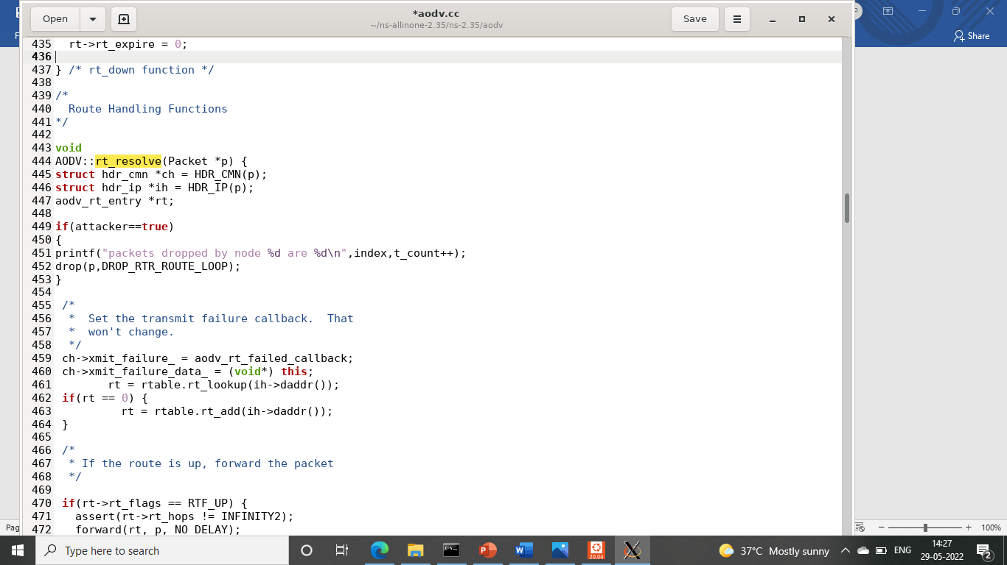
After installing open the AODV.cc file and AODV.h file to make changes
Adov.cc

Slide 13
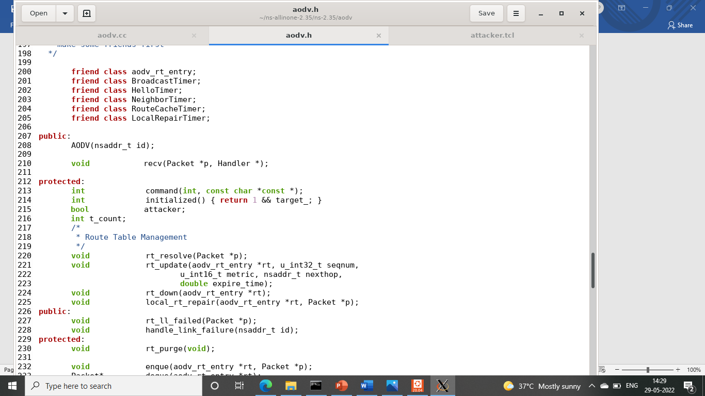
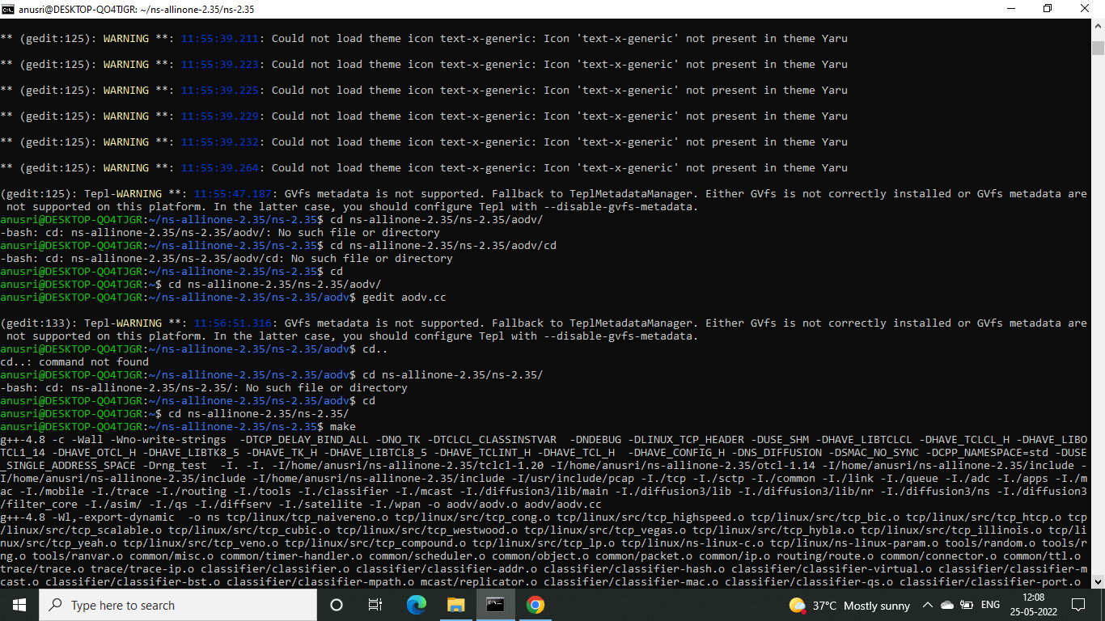
Adov.h
Now we build the codes.

Slide 14
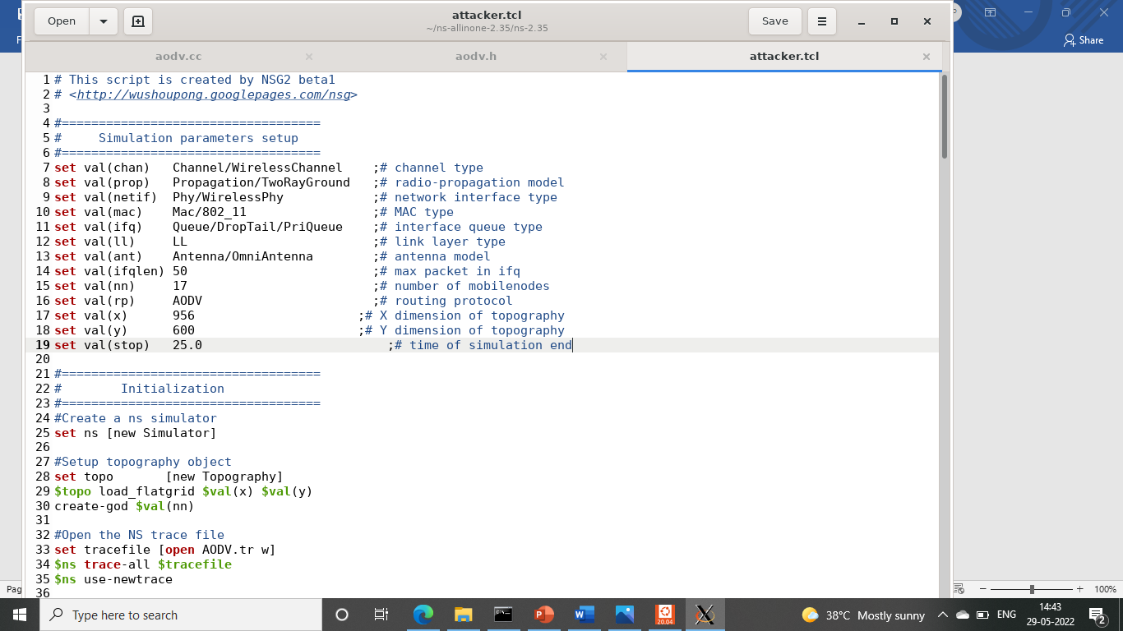
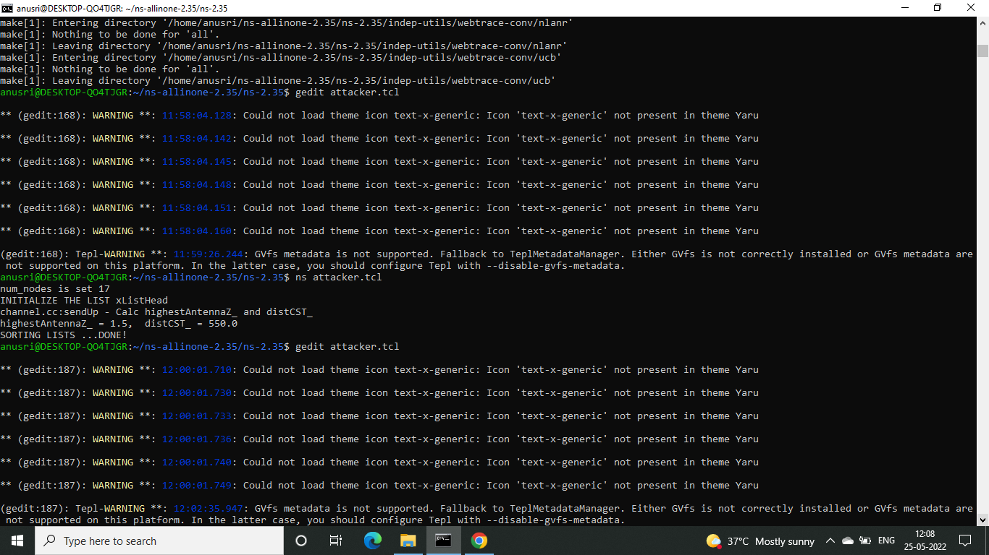
Now create a tcl code with no attacks:
Run the code. In this since there is no attacker node no packets are dropped

Slide 15
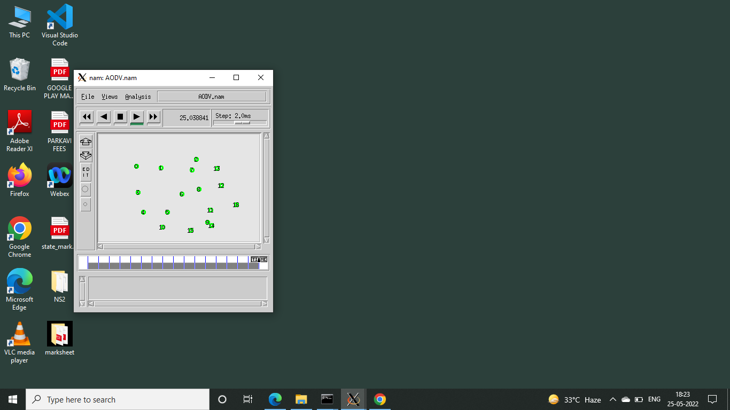
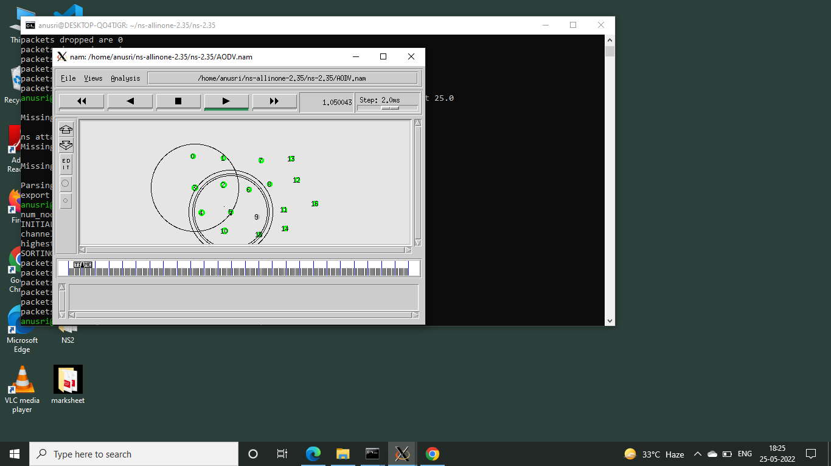

Slide 16
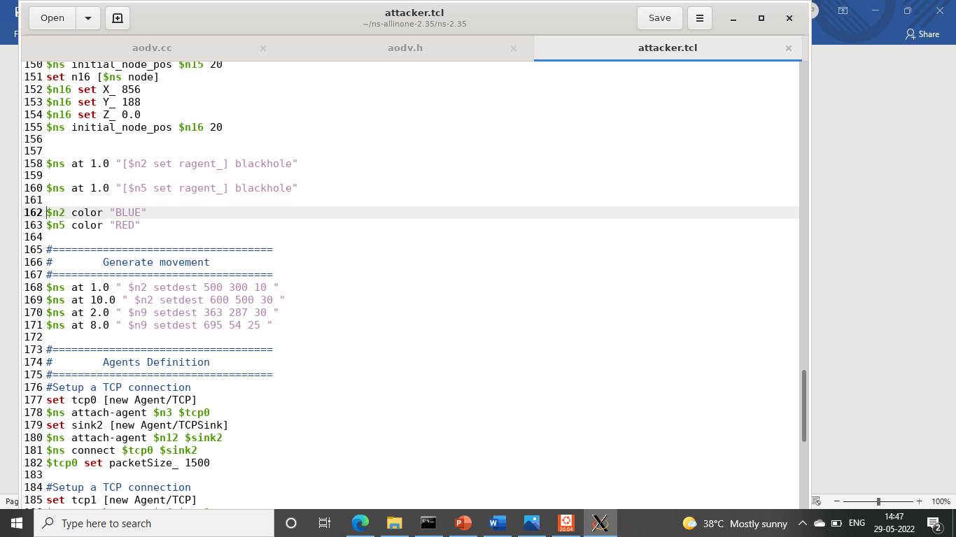
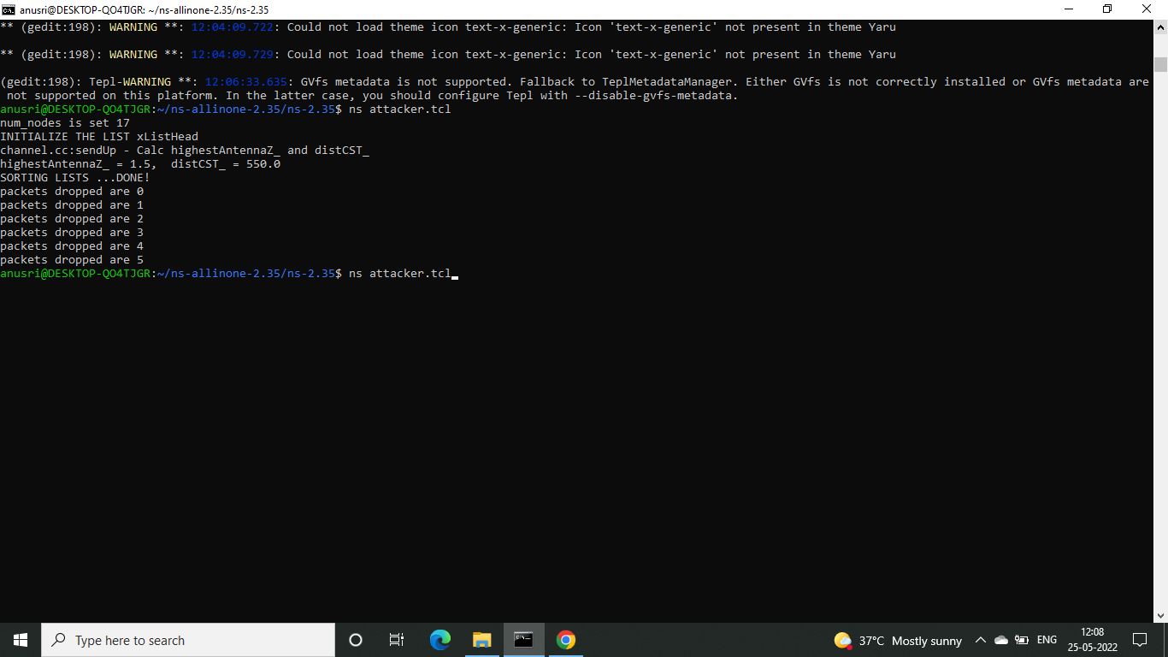
Build a code with attacker node:
Attack is generated and packets are dropped

Slide 17


Output of attack generation

Slide 18


Here we can see node 5 dropping a packet

Slide 19
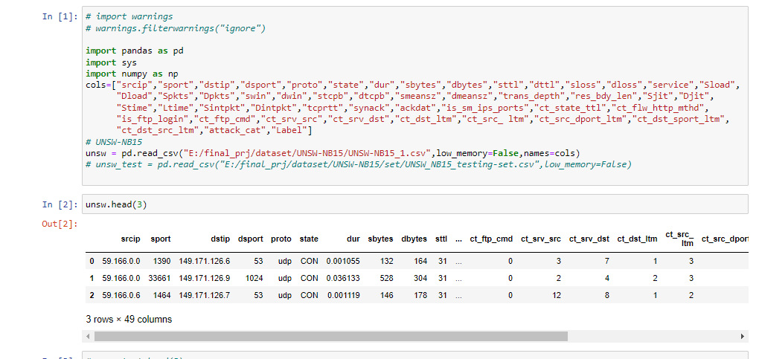
PRE-PROCESSING:
Insert dataset

Slide 20
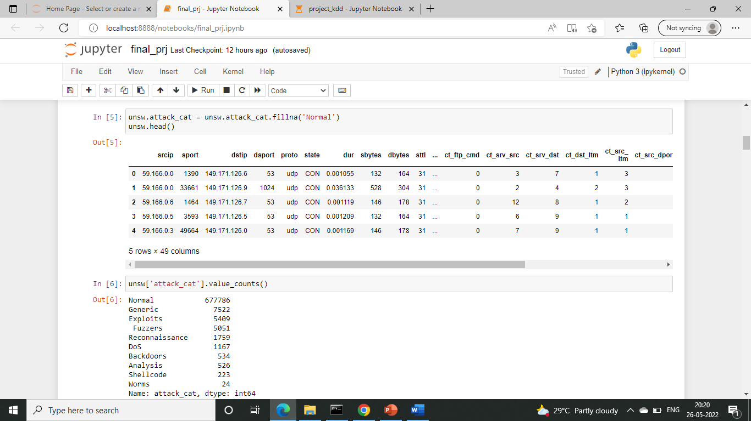
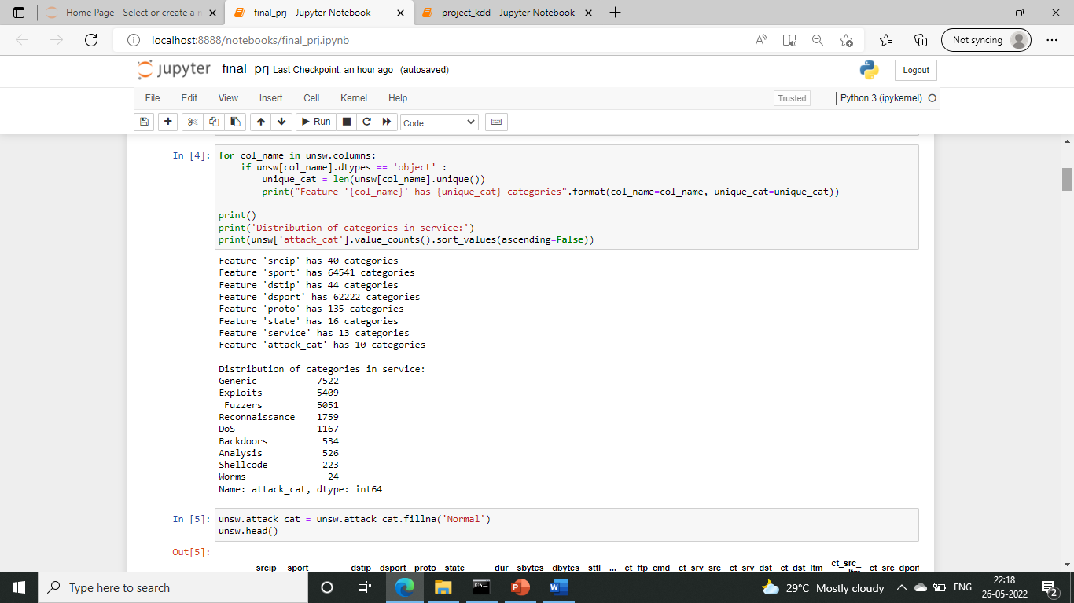
Checking for null values and replacing:
Identify Unique feature category

Slide 21
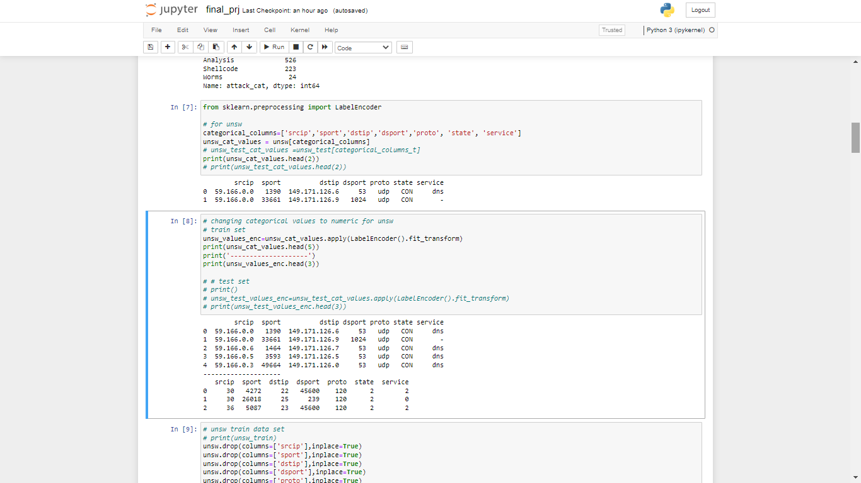
Convert to numeric values:

Slide 22
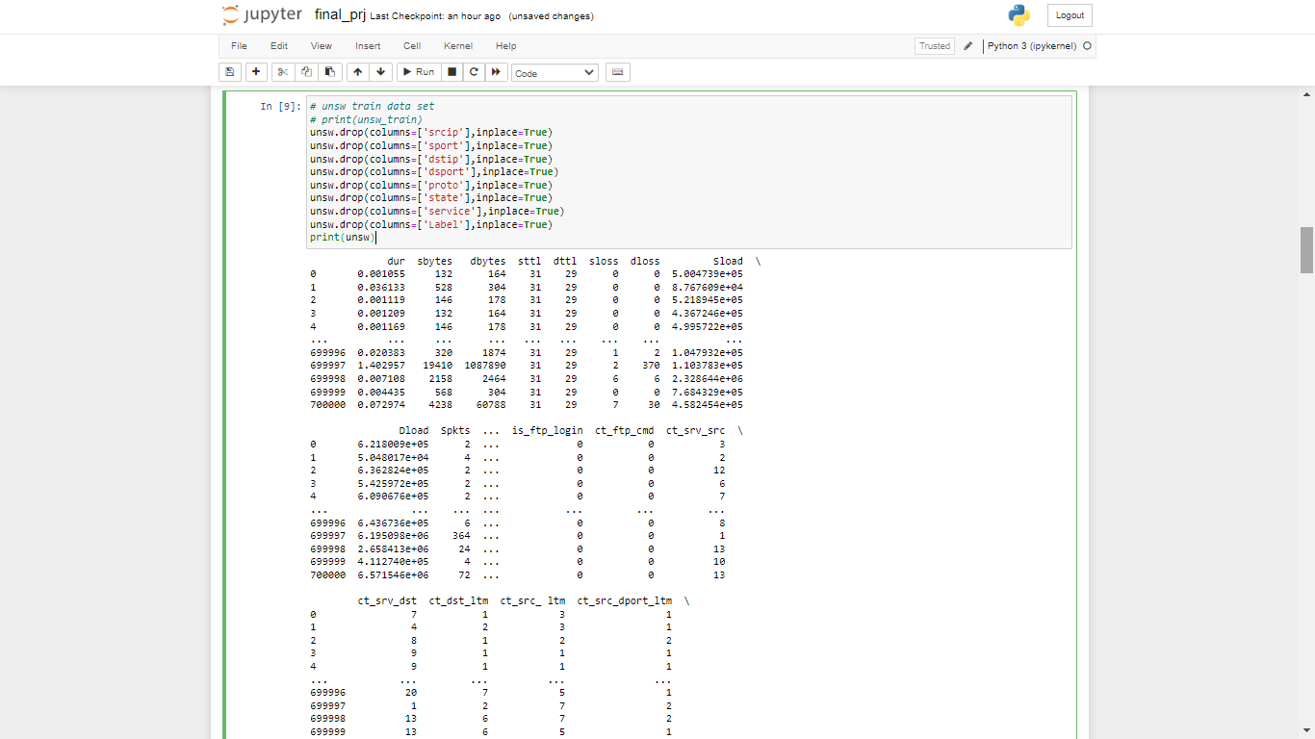
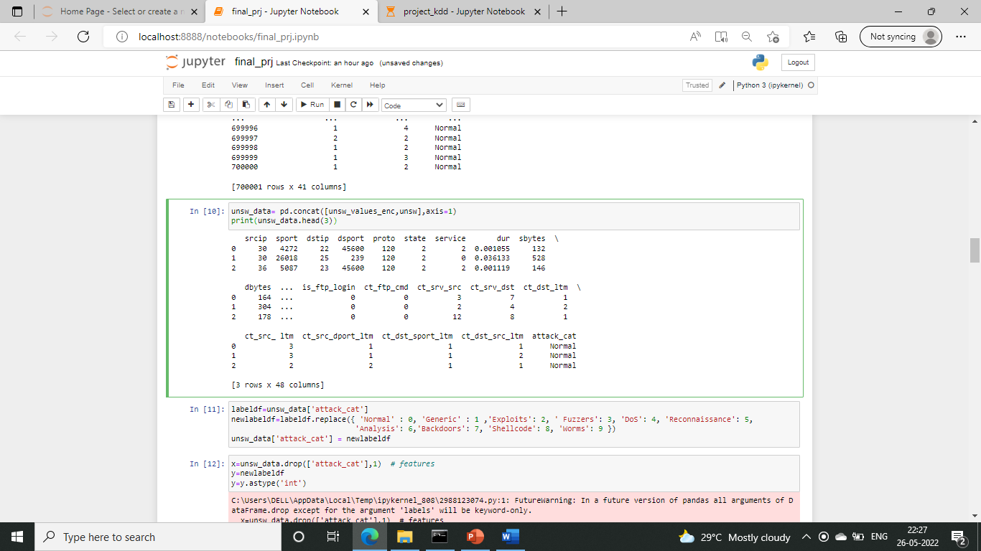
Dropping the columns and concatenating with categorical values

Slide 23
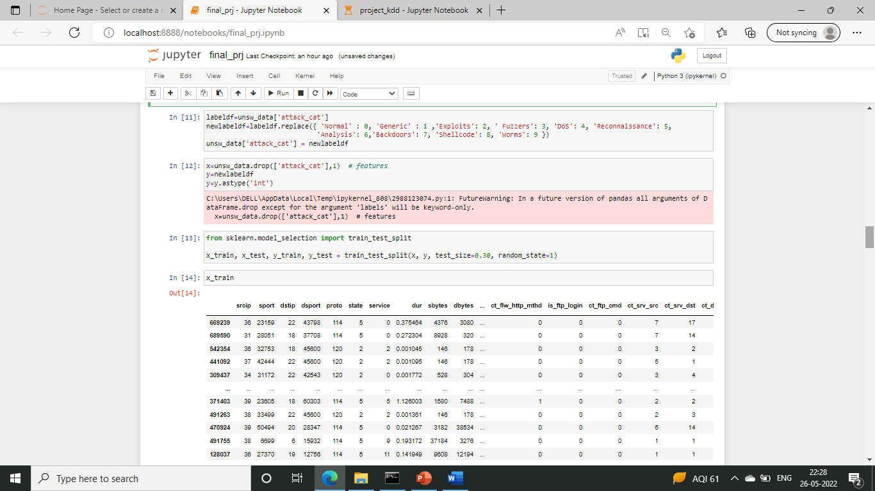
Dividing training and testing set:

Slide 24
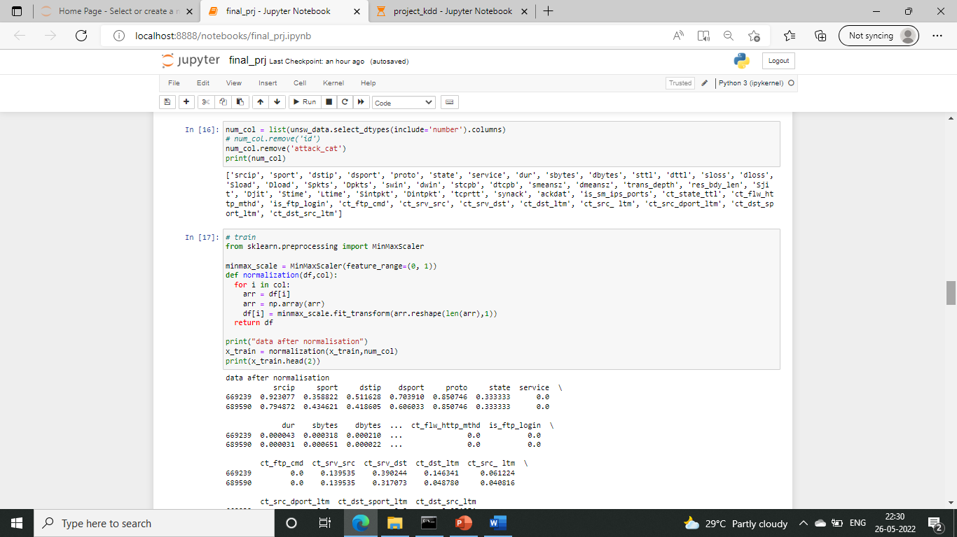
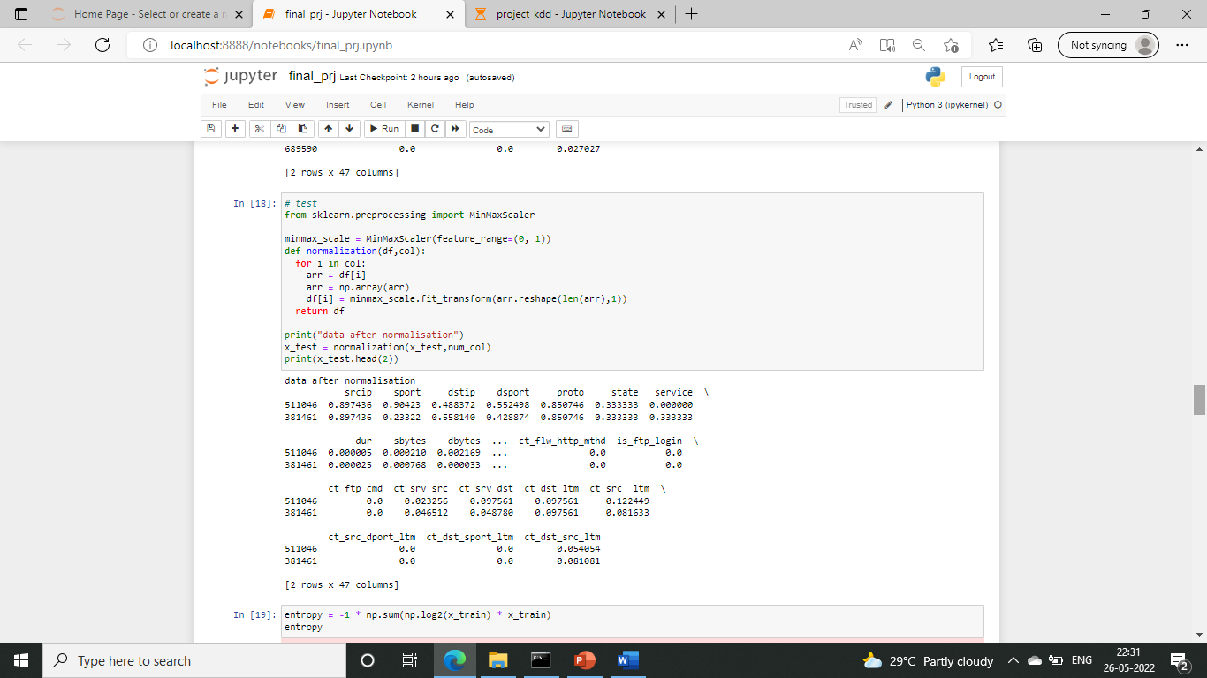
Normalization:
For training set
For testing set

Slide 25
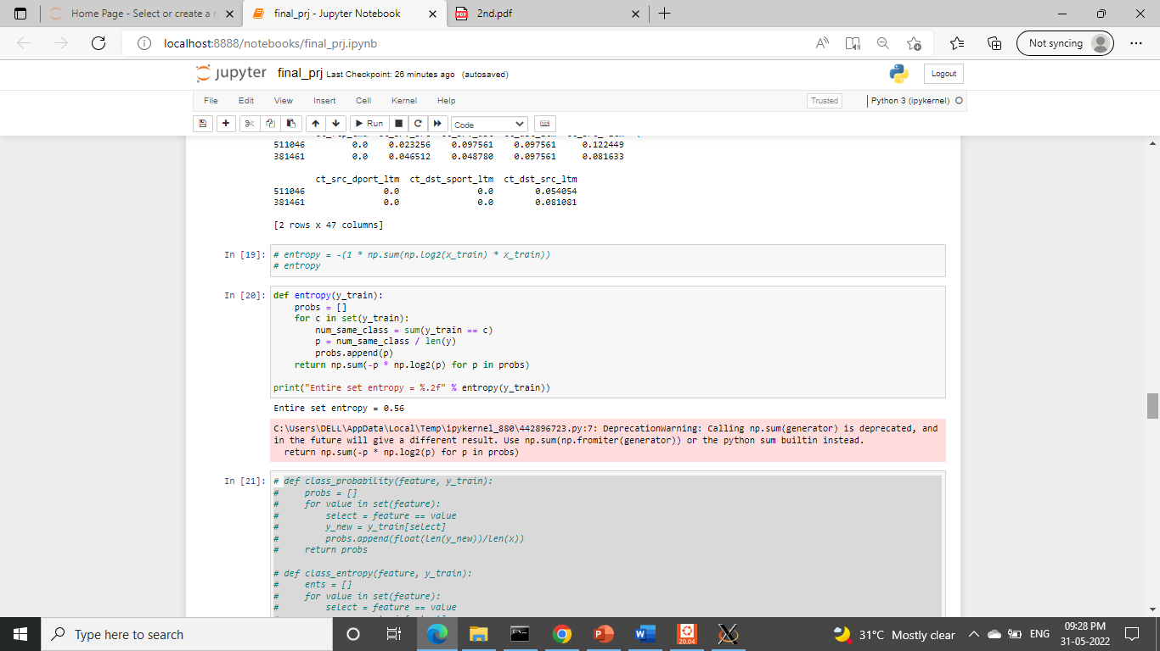
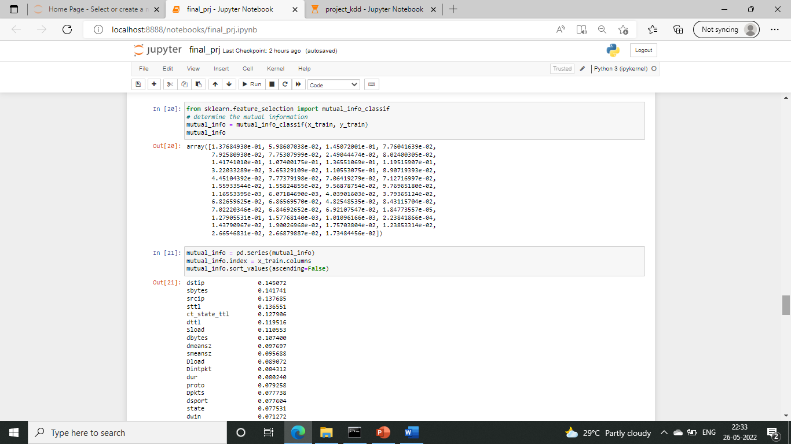
FEATURE SELECTION AGENT:
Entropy:
Mutual information gain:

Slide 26
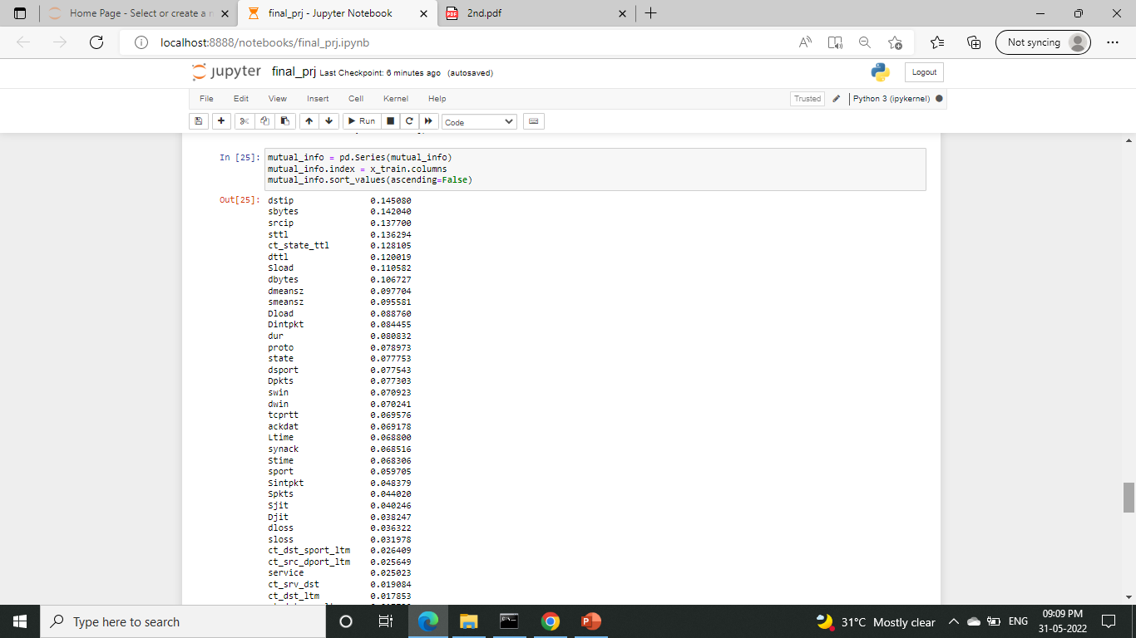
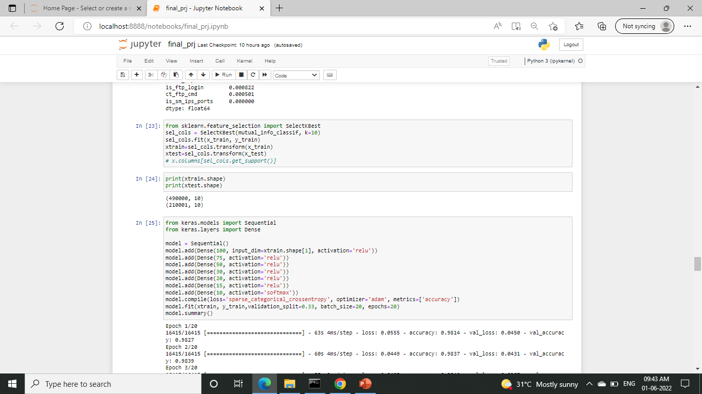

Slide 27
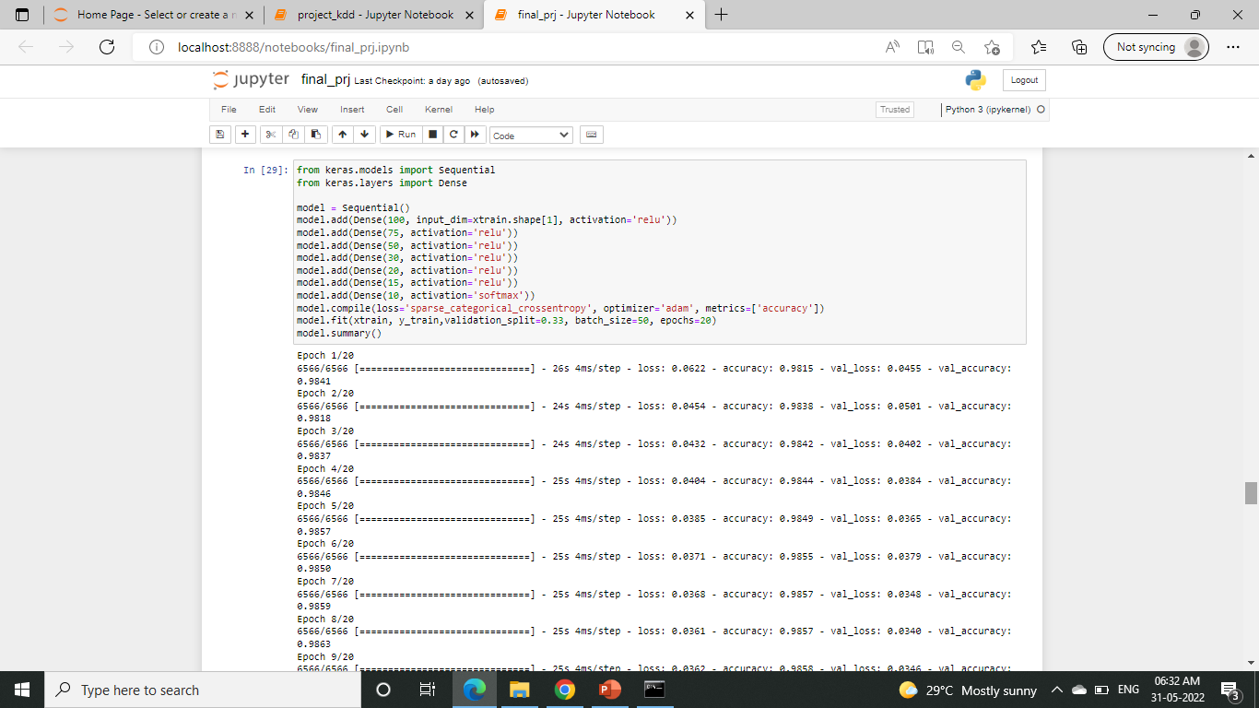
DNN ALGORITHM USING FEATURES SELECTED FROM MUTUAL INFORMATION GAIN

Slide 28
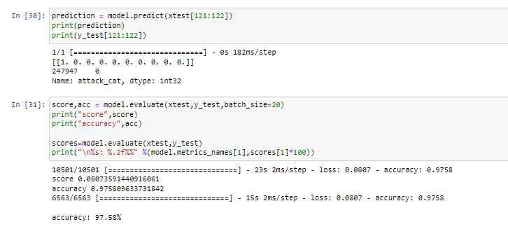
Predicted model accuracy

Slide 29
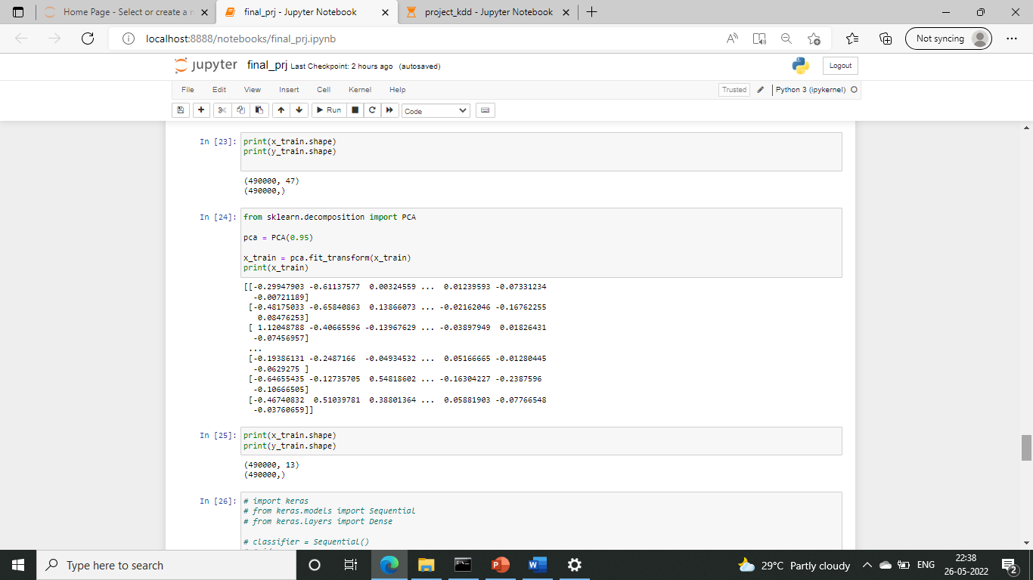
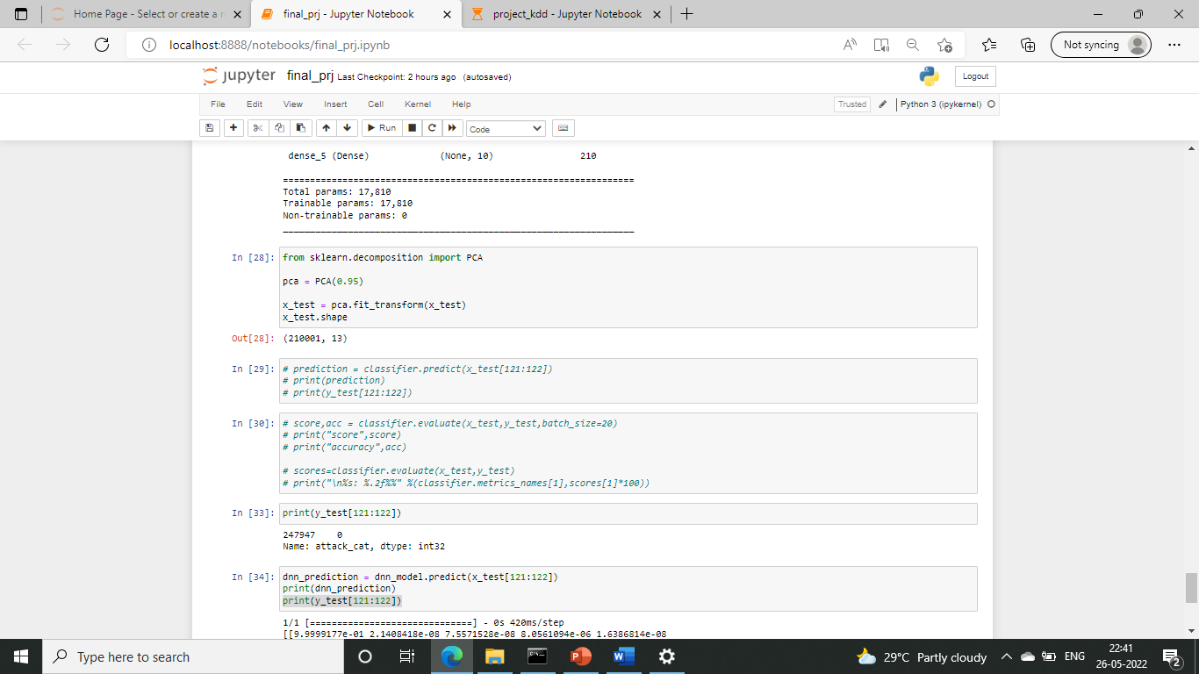
Principal Component Analysis:
For training set:
For testing set:

Slide 30
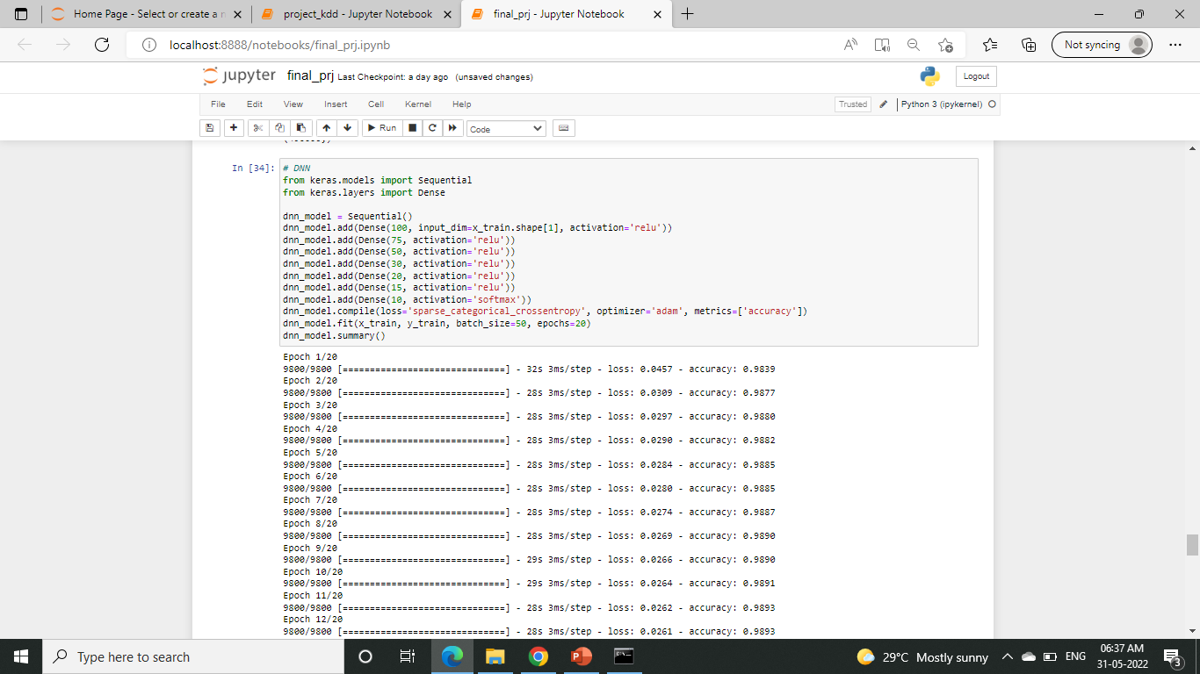
CLASSIFICATION STRATEGY:
Training the model using DNN:

Slide 31
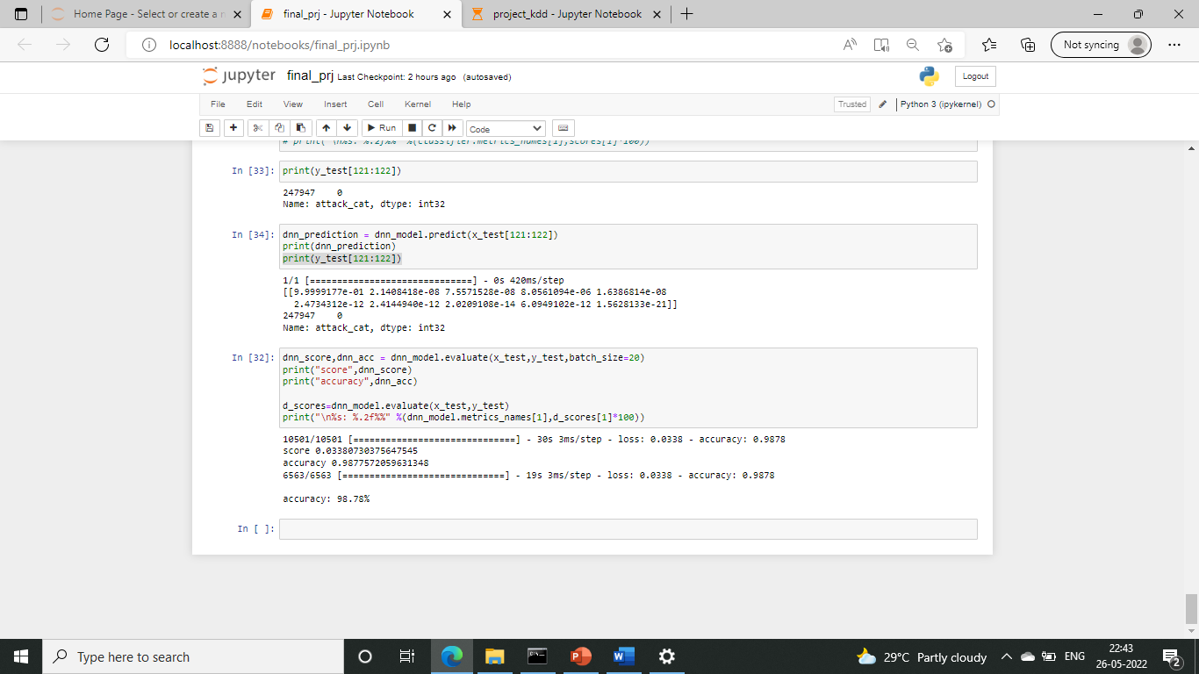
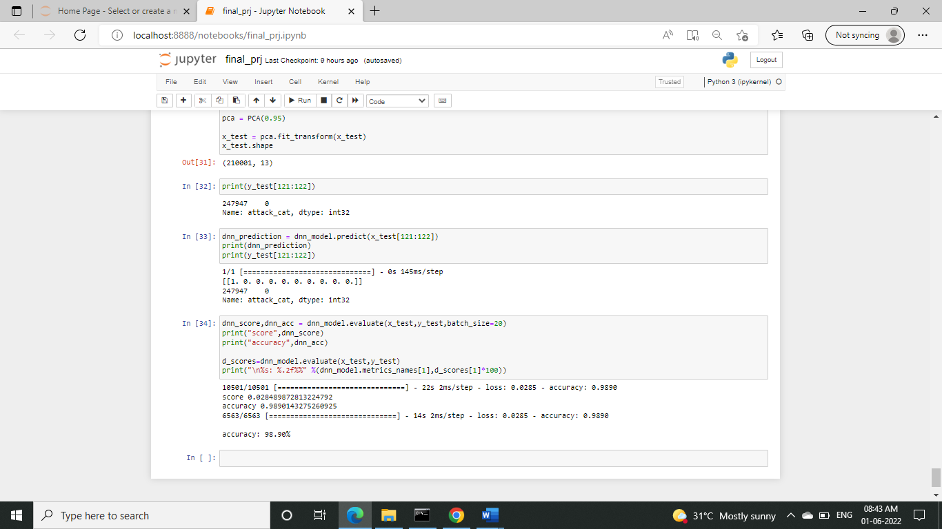
Score and accuracy

Slide 32
Result
The attack is generated in tcl language with the help of aodv protocols and the attacker packets are dropped.
This stimulation generates an .nam file which will be used in the next phase to detect the attacks.
Then the dataset was trained with the DNN classification algorithm which uses Relu activation and softmax activation methods.
After training the dataset it was evaluated using the test dataset and predict the results.
The result acquired was the expected output and the accuracy of my model is 98.9%.

Slide 33
REFERENCES
https://www.educative.io/edpresso/one-hot-encoding-in-python
https://machinelearningmastery.com/start-here/
https://github.com/alik604/cyber-security/blob/master/Intrusion-Detection/UNSW_NB15.ipynb
https://www.youtube.com/watch?v=Fw5iiyIHzew
https://github.com/Ahamasaleh/Deep-learning-for-intrusion-detection-using-RecurrentneuralnetworkRNN/blob/main/KDDTest%2BBinary_Classification.ipynb
https://github.com/abhinav-bhardwaj/IoT-Network-Intrusion-Detection-System-UNSW-NB15/blob/master/UNSW_Project.ipynb

Slide 34
THANK YOU

